Slide 1
OPERATING SYSTEMS
Razi Uddin
Lecture # 26

Slide 2



Virtual Memory

Slide 3

VIRTUAL MEMORY
Virtual Memory is the separation of user logical memory from physical memory.
This separation allows an extremely large virtual memory to be provided for programmers when only a smaller physical memory is available.
Virtual memory makes the task of programming easier because the programmer need not worry about the amount of physical memory, or about what code can be placed in overlays; she can concentrate instead on the problem to be programmed.
Virtual memory also allows files and memory to be shared by several different processes through page sharing.
The sharing of pages further allows performance improvements during process creation.
Virtual memory is commonly implemented as demand paging.
It can also be implemented in a segmentation system.
One benefit of virtual memory is efficient process creation.
Yet another is the concept of memory-mapped files

Slide 4
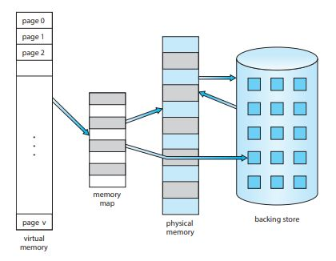
VIRTUAL MEMORY

Slide 5
DEMAND PAGING
A demand paging system is similar to a paging system with swapping.
Processes reside on secondary memory (which is usually a disk).
When we want to execute a process, we swap it into memory.
Rather than swapping the entire process into memory, however, we use a lazy swapper.
A lazy swapper never swaps a page into memory unless that page will be needed.
Since we are now viewing a process as a sequence of pages rather than as one large contiguous address space, use of swap is technically incorrect.
A swapper manipulates entire processes, whereas a pager is concerned with the individual pages of a process.
Thus the term pager is used in connection with demand paging.

Slide 6
DEMAND PAGING
When a process is to be swapped in, the paging software guesses which pages would be used before the process is swapped out again.
Instead of swapping in a whole process, the pager brings only those necessary pages into memory.
Thus it avoids reading into memory pages that will not be used anyway, decreasing the swap time and the amount of physical memory needed.
With this scheme, we need some form of hardware support to distinguish which pages are in memory and which are on disk.
Valid-invalid bit can be used for this purpose.

Slide 7
DEMAND PAGING
This time however when the bit is set to valid, this value indicates that the associated page is both legal and in memory.
If the bit is set to invalid this value indicates that the page either is invalid (that is, not in the logical address space of the process) or valid but currently on the disk.
The page table entry for a page that is brought into memory is set as usual but the page table entry for a page that is currently not in memory is simply marked invalid or contains the address of the page on disk.
Notice that marking a page invalid will have no effect if the process never attempts to access that page.

Slide 8
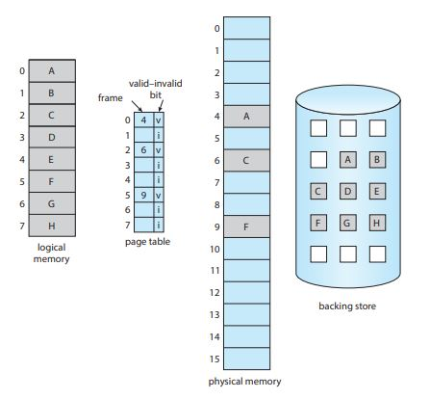
DEMAND PAGING

Slide 9
PAGE FAULT
What happens if the process tries to access a page that was not brought into memory?
Access to a page marked invalid causes a page fault trap.
The paging hardware in translating the address through the page table will notice that the invalid bit is set, causing a trap to the operating system.
The procedure for handling a page fault is straightforward:
We check an internal table (usually kept with the process control block) for this process to determine whether the reference was valid or invalid memory access.
If the reference was invalid we terminate the process. If it was valid, but we have not yet brought in that page, we now page it in.

Slide 10
PAGE FAULT
We find a free frame (by taking one from the free-frame list, for example)
We schedule a disk operation to read the desired page into the newly allocated frame.
When the disk read is complete, we modify the internal table kept with the process and the page table to indicate that the page is now in memory.
We restart the instruction that was interrupted by the illegal address trap.
The process can now access the page as though it had always been in memory.

Slide 11
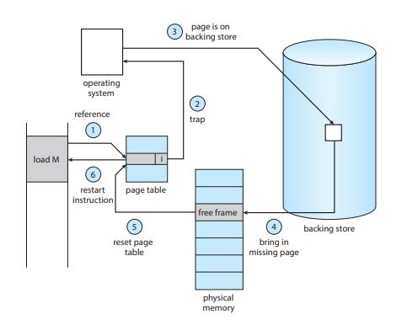
PAGE FAULT

Slide 12
PAGE FAULT
A crucial requirement for demand paging is the ability to restart any instruction after a page fault.
Since we save the state (registers, condition code, instruction counter) of the interrupted process when the page fault occurs, we can restart the process in exactly the same place and state except that the desired page is now in memory and is accessible.
In this way we are able to execute a process even though portions of it are not yet in memory.
When the process tries to access locations that are not in memory, the hardware traps the operating system (page fault).
The operating system reads the desired into memory and restarts the process as though the page had always been in memory.

Slide 13
PAGE FAULT
In the extreme case, we could start executing a process with no pages in memory.
When the operating system sets the instruction pointer to the first instruction of the process, which is on a non-memory resident page, the process immediately faults for the page.
After this page is brought into memory, the process continues to execute faulting as necessary until every page that it needs is in memory.
At that point, it can execute with no more faults.
This scheme is called pure demand paging: never bring a page into memory until it is required.

Slide 14
PAGE FAULT
The hardware needed to support demand paging is the same as the hardware for paging and swapping:
Page table—This table has the ability to mark an entry invalid through a valid invalid bit or special value of protection bits.
Secondary memory—This memory holds those pages that are not present in the main memory.
The secondary memory is usually a high-speed disk.
It is known as the swap device, and the section of disk used for this purpose is called the swap space.

Slide 15
PAGE REPLACEMENT
While a user process is executing, a page fault occurs.
The hardware traps to the operating system, which checks its internal tables to see that this page is a genuine one rather than an illegal memory access.
The operating system determines where the desired page is residing on the disk, but then finds that there are no free frames on the free frame list.
All memory is in use.
The operating system has several options at his point.

Slide 16
PAGE REPLACEMENT
It could terminate the user process.
However, demand paging is the operating system’s attempt to improve the computer system’s utilization and throughput.
Users’ should not be aware that their processes are running on a paged system – paging should be logically transparent to the user.
So this option is not the best choice.
The operating system could swap out a process, but that would reduce the level of multiprogramming.
So we explore page replacement.
This means that if no free frame is available on a page fault, we replace a page in memory to load the desired page. The page-fault service routine is modified to include page replacement. We can free a frame by writing its contents to swap space, and changing the page table to indicate that the page is no longer in memory.

Slide 17
PAGE REPLACEMENT
The modified page fault service routine is:
Find the location of the desired page on the disk
Find a free frame.
If there is a free frame use it.
If there is no free frame, use a page replacement algorithm to select a victim frame.
Read the desired page into the newly freed frame; change the page and frame tables.
Continue the process from where the page fault occurred..

Slide 18
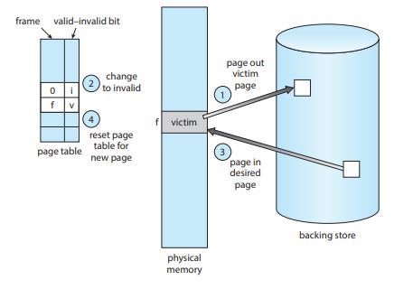
PAGE REPLACEMENT

Slide 19
PAGE REPLACEMENT
We can reduce overhead by using a modify bit (or dirty bit).
Each page or frame may have a modify bit associated with it in hardware.
The modify bit is set by the hardware whenever any word or byte in the page is written into, indicating that the page has been modified.
When we select a page for replacement we examine it’s modify bit.
If the bit is set, we know that the page has been modified since it was read in from the disk.
In this case we must write that page to the disk.
If the modify bit is not set, however, the page has not been modified since it was read into memory, and hence we can avoid writing that page to disk.

Slide 20
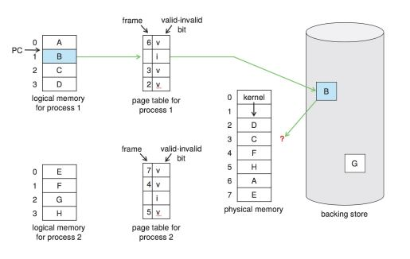
PAGE REPLACEMENT

Slide 21


PAGE REPLACEMENT ALGORITHMS

Slide 22
FIFO PAGE REPLACEMENT
The simplest page-replacement algorithm is a FIFO algorithm.
A FIFO replacement algorithm associates with each page the time when that page was brought into memory.
When a page must be replaced, the oldest page is chosen.
Notice that it is not strictly necessary to record the time when a page is brought in.
We can create a FIFO queue to hold all pages in memory.
We replace the page at the head of the queue.
When a page is brought into memory we insert t at the tail of the queue.

Slide 23
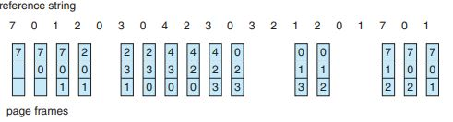
FIFO PAGE REPLACEMENT
There are fifteen faults altogether

Slide 24
FIFO PAGE REPLACEMENT
The FIFO page-replacement algorithm is easy to understand and program.
However, its performance is not always good.
If we select for replacement a page that is in active use, everything still works correctly.
After we replace an active page with a new one, a fault occurs almost immediately to retrieve the active page.
Some other page must be replaced to bring the active page back into memory.
Thus, a bad replacement choice increases the page-fault rate and slows process execution.
It does not, however, cause incorrect execution.

Slide 25
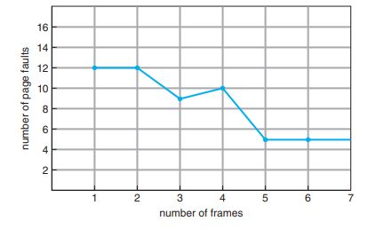
FIFO PAGE REPLACEMENT

Slide 26
FIFO PAGE REPLACEMENT
Notice that the number of faults for four frames (ten) is greater than the number of faults for three frames (nine)!
This most unexpected result is known as Belady’s anomaly: for some page-replacement algorithms, the page-fault rate may increase as the number of allocated frames increases.
We would expect that giving more memory to a process would improve its performance.
In some early research, investigators noticed that this assumption was not always true.
Belady’s anomaly was discovered as a result.

Slide 27
OPTIMAL PAGE REPLACEMENT
One result of the discovery of Belady’s anomaly was the search for an optimal page-replacement algorithm.
The algorithm that has the lowest page-fault rate of all algorithms and will never suffer from Belady’s anomaly.
Such an algorithm does exist and has been called OPT.
It is simply said:
Replace the page that will not be used for the longest period of time.
Use of this page-replacement algorithm guarantees the lowest possible page-fault rate for a fixed number of frames.

Slide 28
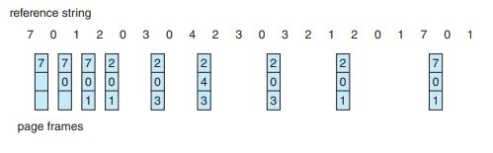
OPTIMAL PAGE REPLACEMENT
There are nine faults altogether

Slide 29
OPTIMAL PAGE REPLACEMENT
With only nine page-faults, optimal replacement is much better than a FIFO algorithm, which results in fifteen faults.
(If we ignore the first three, which all algorithms must suffer, then optimal replacement is twice as good as FIFO replacement.)
In fact, no replacement algorithm can process this reference string in three frames with fewer than nine faults.
Unfortunately, the optimal page-replacement algorithm is difficult to implement, because it requires future knowledge of the reference string.
(We encountered a similar situation with the SJF CPU-scheduling algorithm.)
As a result, the optimal algorithm is used mainly for comparison studies.

Slide 30
LRU PAGE REPLACEMENT
If the optimal algorithm is not feasible, perhaps an approximation of the optimal algorithm is possible.
The key distinction between the FIFO and OPT algorithms (other than looking backward versus forward in time) is that the FIFO algorithm uses the time when a page was brought into memory, whereas the OPT algorithm uses the time when a page is to be used.
If we use the recent past as an approximation of the near future, then we can replace the page that has not been used for the longest period of time.
This approach is the least recently used (LRU) algorithm.
LRU replacement associates with each page the time of that page’s last use.
When a page must be replaced, LRU chooses the page that has not been used for the longest period of time.

Slide 31
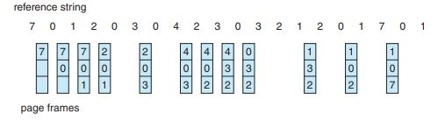
LRU PAGE REPLACEMENT
There are twelve faults altogether

Slide 32
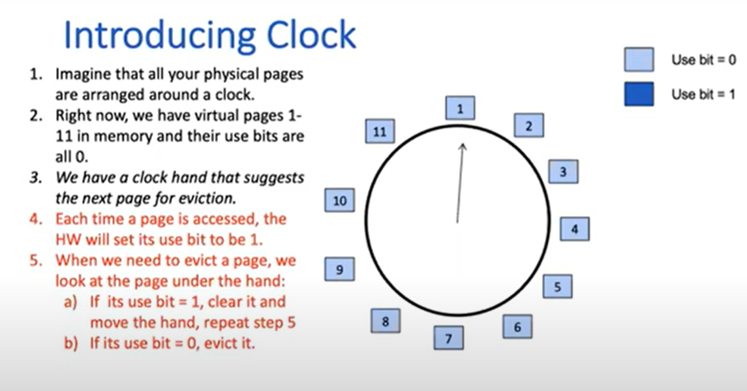

Slide 33
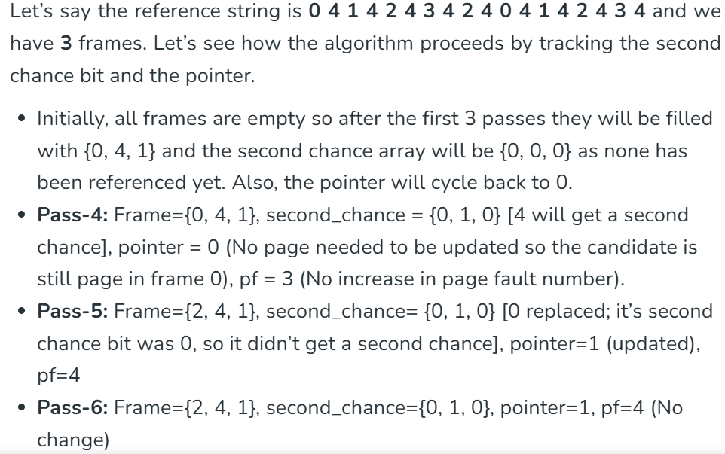

Slide 34
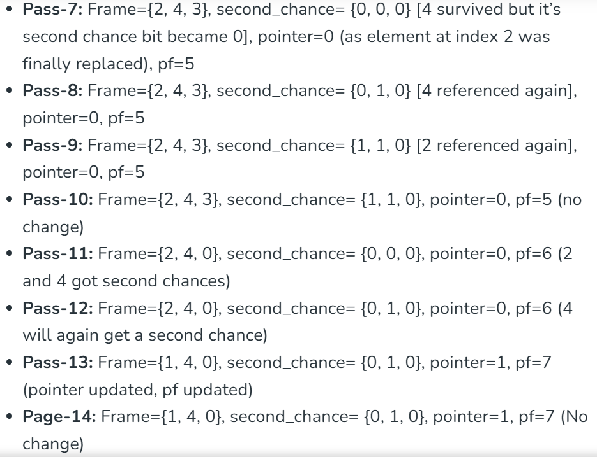

Slide 35
